Slide 1
Disease Overview of
Nonalcoholic Steatohepatitis (NASH):
The Active, Progressive Form of
Nonalcoholic Fatty Liver Disease (NAFLD)
Christina Hanson, MS, FNP, South Denver Gastroenterology
Ann Moore, FNP-C, Arizona Liver Health
Medical Affairs

Slide 2
Outline
Definitions and epidemiology
Pathophysiology
Natural history of the disease
Morbidity and mortality
Risk factors
Patient identification
Patient perspective
Conclusions

Slide 3
Definitions and Epidemiology

Slide 4
Nonalcoholic Fatty Liver Disease Ranges From Simple Steatosis to
Nonalcoholic Steatohepatitis
NAFLD: Nonalcoholic fatty liver disease^{1–4}
  Entire spectrum of fatty liver disease in individuals without significant alcohol consumption
NAFL: Nonalcoholic fatty liver
NASH: Nonalcoholic steatohepatitis
  Isolated steatosis
  (fat in ≥5% of hepatocytes)
  Active form of the disease characterized by
  Steatosis
  Ballooning
  Inflammation
NASH with fibrosis^{3,4}
  NASH (steatosis, ballooning, inflammation)
  Fibrosis
  Mild: Fibrosis stage 1 (F1)
  Significant: Fibrosis stages 2 and 3 (F2/F3)
  Cirrhosis: Fibrosis stage 4 (F4)
F, fibrosis stage; NAFL, nonalcoholic fatty liver; NAFLD, nonalcoholic fatty liver disease; NASH, nonalcoholic steatohepatitis.
1. Sheka AC, et al. JAMA. 2020;323(12):1175–1183; 2. Alkhouri N, McCullough AJ. Gastroenterol Hepatol (N Y). 2012;8(10):661–668; 3. EASL–EASD–EASO. J Hepatol. 2016;64:1388–1402; 4. Diehl AM and Day C. N Engl J Med. 2017;377:3063–3072.

Slide 5

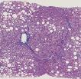

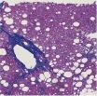

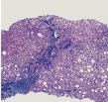
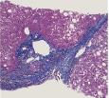
The Chronic Liver Injury Drives Disease Progression and Fibrosis in Nonalcoholic Steatohepatitis
NASH is the inflammatory subtype of NAFLD, which can progress to cirrhosis, liver cancer or result in death^{1–5}
Normal liver
NAFL
NASH
NASH with fibrosis
Fat
accumulation
Histology
Histology
Histology
Steatosis
Steatosis
Fibrosis stage 1
Lobular
inflammation
Fibrosis stage 2
Ballooning
degeneration
Fibrosis stage 3
Fibrosis stage 4
F, fibrosis stage; NAFL, nonalcoholic fatty liver; NAFLD, nonalcoholic fatty liver disease; NASH, nonalcoholic steatohepatitis.
1. Sheka AC, et al. JAMA. 2020;323(12):1175–1183; 2. Alkhouri N, McCullough AJ. Gastroenterol Hepatol (N Y). 2012;8(10):661–668; 3. EASL–EASD–EASO. J Hepatol. 2016;64:1388–1402; 4. Diehl AM and Day C. N Engl J Med. 2017;377:3063–3072; 5. Honda Y, et al. Int J Mol Sci. 2020;21:4039.

Slide 6

Nonalcoholic Fatty Liver Disease is Strongly Associated with Obesity and Diabetes, Growing Burdens of Disease
Asia
27.4%
Worldwide prevalence of NAFLD is 25%¹
North America 24.1%
Europe
23.7%
Middle East
31.8%
In T2DM
52.0–57.9%
In T2DM (US) 51.8%
In T2DM
68.0%
In T2DM
67.3%
Worldwide prevalence of NAFLD among people with T2DM is 55–60%²
South America 30.5%
Africa
13.5%
In T2DM
30.4%
In T2DM
56.8%
Worldwide prevalence of NAFLD among people with obesity is between 70–80% and even over 90% among morbid obesity³
Global prevalence of NASH in general population is between 1.5–6.45%¹
Global prevalence of NASH among type 2 diabetes mellitus (T2DM) is 37.3% (24.7–50.0%)²
NAFLD, nonalcoholic fatty liver disease; NASH, nonalcoholic steatohepatitis; T2DM, type 2 diabetes mellitus.
1. Younossi ZM, et al. Hepatology. 2016;64(1):73–84; 2. Younossi ZM, et al. J Hepatol. 2019;71(4):793–801; 3. Polyzos SA, et al. Metabolism. 2019;92:82–97.

Slide 7
Modeling the Epidemic of Nonalcoholic Steatohepatitis Demonstrates an Exponential Increase in Burden of Disease
Study aim: Develop dynamic model of NAFLD to assess health burden of the disease at population level
Markov model used to forecast NAFLD disease progression
Total US NAFLD population projected to increase 21% (2015 to 2030)
Total US NASH population projected to increase 63% (2015 to 2030)
63%↑
27
F4
16.5
F3
F2
F1
F0
NAFLD, nonalcoholic fatty liver disease; NASH, nonalcoholic steatohepatitis.
Adapted from Estes C, et al. Hepatology. 2018;67:123–133.

Slide 8
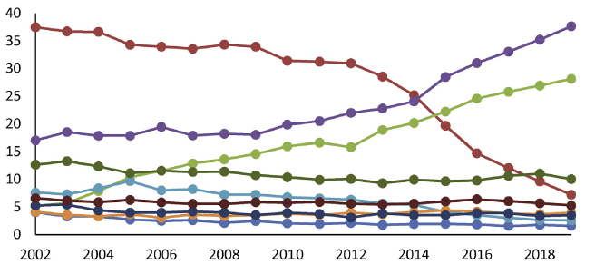
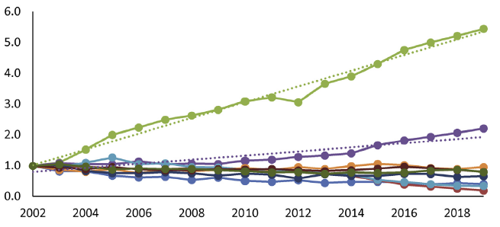
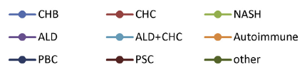
Nonalcoholic Steatohepatitis Is an Increasing Indication for Liver Transplantation in the US
Prevalence of the most common chronic liver disease (CLD) etiologies in waitlisted liver transplant candidates without HCC¹
Proportion of non-HCC listings, %
Proportion relative to 2002 level
NASH is currently the leading cause for liver transplant waitlist registration/liver transplantation in females and the second leading cause overall^{1,2}
ALD, alcoholic liver disease; CHB, chronic hepatitis B; CHC, chronic hepatitis C; CLD, chronic liver disease; HCC, hepatocellular carcinoma; NASH, nonalcoholic steatohepatitis; PBC, primary biliary cirrhosis; PSC, primary sclerosing cholangitis.
1. Younossi ZM, et al. Clin Gastroenterol Hepatol. 2021;19:580–589. 2.Noureddin M, et al. Amer. J. Gastroenterol. 2018;113:1649–1659.

Slide 9
Pathophysiology

Slide 10
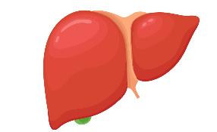

Energy Excess and Metabolic Inflexibility Can Lead To Hepatic Steatosis
Energy input
=
Calories consumed
Δ: Energy storage
Adipose tissue and other organs
Adipose tissue
Diet
Lipids spill over
Energy output
=
Calories burned
Lifestyle /
basal metabolic rate
Liver
Skeletal muscle
Metabolic flexibility requires body to have ability to adequately handle fuels & use appropriate substrates at appropriate times
Inability to maintain homeostatic control to handle fuel needs & appropriately use substrates tips energy balance scale towards higher intake & storage, ultimately leading to lipotoxic cell stress
Adapted from Chakravarthy MV and Neuschwander-Tetri BA. Endocrinol Diabetes Metab. 2020;3(4):e00112.

Slide 11
Pathogenesis of Nonalcoholic Steatohepatitis Involves Lipotoxicity
Normal hepatocyte
Fatty hepatocyte
Fatty and injured hepatocyte
Apoptotic hepatocyte
Adipose tissue
Gut and microbiome
Adipose tissue
Gut and microbiome
Adipose tissue
Gut and microbiome
Lipotoxicity
Ballooned
Cell signals
Various factors (genetic mutation, altered lipid homeostasis, hyperinsulinemia or insulin resistance) induce chronic liver steatosis, leading to metabolic, oxidative and endoplasmic reticulum stress (i.e. lipotoxicity)
Lipotoxicity further leads to hepatocyte injury and apoptosis
Necrotic and apoptotic hepatocytes release signals, which recruit and activate repair-related cells
Repair-related cells accumulate and initiate wound-healing responses, which include release of inflammatory cytokines, collagen deposition, vascular remodeling and accumulation of immature biliary cells
NASH is the sum of injury and repair responses triggered by lipotoxicity
Repair-related cells
Immune
cells
Activated
sinusoidal
endothelium
Myofibroblastic
stellate cell
Reactive
ductal cells
Wound-healing responses
Inflammation, vascular remodeling, fibrogenesis,
and accumulation of immature liver epithelial cells
Adapted from Diehl AM and Day C. New Engl J Med. 2017;377:3063–3072.

Slide 12
Depressed Liver Thyroid Hormone Signaling Can Lead To Impaired Hepatic Function
Liver thyroid hormone signaling activates lipid metabolism and contributes to normal liver function^{1,2,3}
Liver injury can induce impairment of intrahepatic thyroid hormone signaling, characterized by low conversion of T4 to T3 and high conversion of T4 to inactive form reverse T3^{4,5}
Impaired hepatic thyroid hormone signaling can lead to further accumulation of lipotoxic species, fueling a vicious cycle of liver injury⁴
Β-oxidation followed by tricarboxylic acid
Utilization
TH
Liver
Uptake
Fatty acids
Synthesis
De novo lipogenesis
TH
Secretion
VLDL-triglyceride rich
T3, triiodothyronine; T4, thyroxine; TH, thyroid hormone.
1. Ritter MJ, et al. Hepatology. 2020;72(2):742–752; 2. Sinha RA, et al, Nat Rev Endocrinol. 2018;14(5):259–269; 3. Moran C, et al. J Clin Endocrinol Metab. 2021;106(5):e2005-e2014. 4. Bohinc BN, et al. Endocrinology. 2014;155(11):4591–4601. 4; 5. Taub R, et al. ATA 2021 poster #248.

Slide 13
Natural History of the Disease

Slide 14
Progression of Nonalcoholic Steatohepatitis Can Lead To Cirrhosis and Hepatocellular carcinoma
Prevalence in the US¹:
25% of adults
5─6% of adults
1─2% of adults
Unknown
NAFLD
25%
Cirrhosis
25%
NASH
25%
1–4%/yr
HCC
No NAFLD
75%
Steatosis, inflammation, hepatocellular injury, ± fibrosis
F4 fibrosis
10-year cumulative HCC risk of 1.7 per 1000 patients
20% of NASH-related hepatocellular carcinomas identified in patients without cirrhosis^{2,3}
F, fibrosis stage; HCC, hepatocellular carcinoma; NAFLD, nonalcoholic fatty liver disease; NASH, nonalcoholic steatohepatitis.
1. Younossi ZM, et al. Hepatology. 2016;64(1):73–84; 2. Diehl AM, Day C. N Engl J Med. 2017;377:3063–3072; 3. Kanwal F, et al. Gastroenterology. 2018;155(6):1828–1837.

Slide 15
Morbidity and Mortality

Slide 16
Fibrosis Severity is Increasingly Associated with Morbidity and Mortality
The risk of liver-related death is statistically higher only after progression to F2 or higher¹
Among patients with NASH, those with cirrhosis are at greater risk for decompensation, HCC or death compared with less advanced fibrosis²
Fibrosis stage-specific liver-related mortality rate ratios¹
Clinical outcomes | F3 (n=159) | F4 CTP A5 (n=222) | F4 CTP A6 (n=77)
Overall mortality or liver transplantation | 3% | 11% | 58%
First occurrence of a major clinical event | 16% | 28% | 66%
Hepatic decompensation | 19% | 59% | 85%
HCC | 8% | 19% | 15%
Non-hepatic malignant neoplasm | 38% | 16% | 0
Major vascular event | 35% | 6% | 0
Mortality rate ratio vs F0
Fibrosis stage
Mortality rate ratio (95% CI)
1.41
(0.17–11.95)
9.57
(1.67–54.93)
16.69
(2.92–95.36)
42.30
(3.51–510.34)
CI, confidence interval; CTP, Child–Turcotte–Pugh; F, fibrosis stage; HCC, hepatocellular carcinoma; NASH, nonalcoholic steatohepatitis.
Adapted from: 1. Dulai PS, et al. Hepatology. 2017;65:1557–1565; 2. Vilar-Gomez E, et al. Gastroenterology. 2018;155(2):443–457.

Slide 17
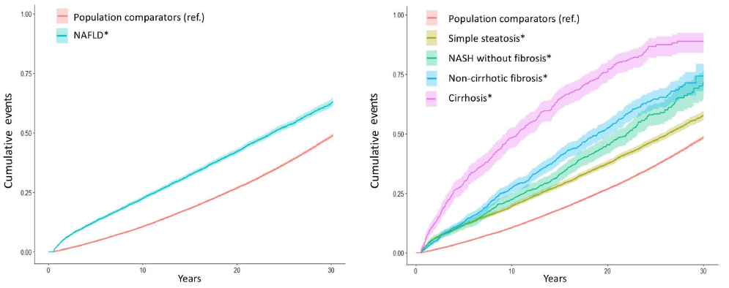
Nonalcoholic Fatty Liver Disease is Associated With an Increased Rate of Mortality
In a Swedish cohort, all NAFLD histological stages were associated with significantly increased overall mortality, and this risk increased progressively with worsening histology
Cumulative incidence of all-cause mortality according to the presence and histological severity of NAFLD
*Histological severity of NAFLD was defined in four categories, as simple steatosis, NASH without fibrosis, non-cirrhotic fibrosis and cirrhosis.
HCC, hepatocellular carcinoma; NAFLD, nonalcoholic fatty liver disease; NASH, nonalcoholic steatohepatitis.
Simon TG, et al. Gut 2021;70(7):1375–1382.

Slide 18
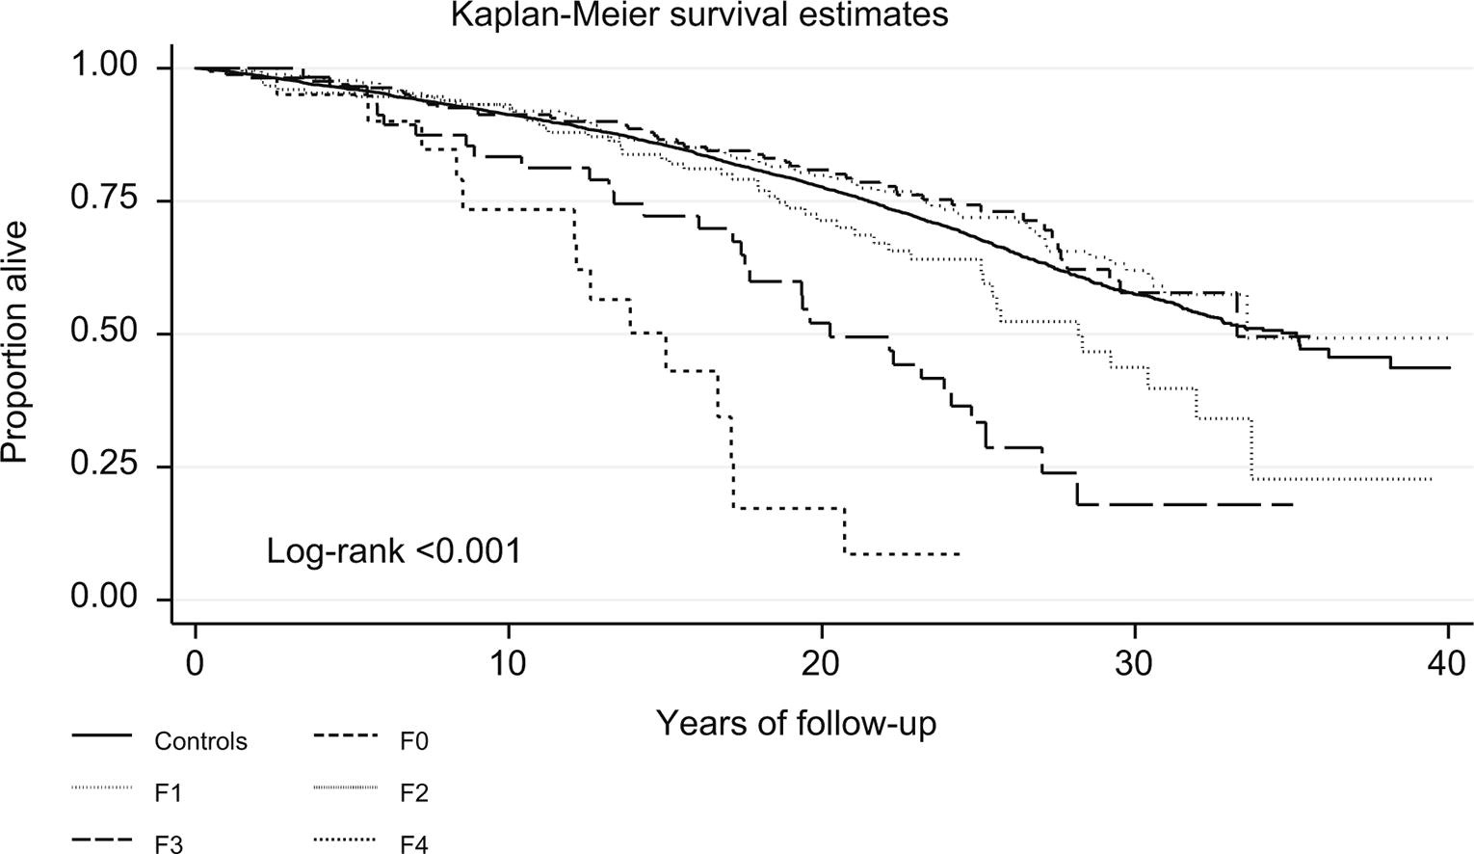
Fibrosis Stage Is Associated With An Increased Rate Of Mortality
All NAFLD fibrosis stages were associated with significantly increased overall mortality, and this risk increased progressively with worsening fibrosis stage
Cumulative incidence of all-cause mortality according to the histological fibrosis stage in NAFLD²
*Histological severity of NAFLD was defined in four categories, as simple steatosis, NASH without fibrosis, non-cirrhotic fibrosis and cirrhosis.
HCC, hepatocellular carcinoma; NAFLD, non-alcoholic fatty liver disease; NASH, non-alcoholic steatohepatitis.
1. Hagstrom et al. J Hepatol. 2017;67:1265-1273.

Slide 19
Major Causes of Death in Patients With Nonalcoholic Fatty Liver Disease
Retrospective analysis of 619 patients from the US, Europe and Thailand diagnosed with NAFLD from 1975 through 2005
Patients underwent lab and biopsy analysis and were examined every 3–12 months after diagnosis
Outcomes analyzed for overall mortality, orthotopic liver transplant (OLT) and liver-related events
Overall median follow up in this study was 12.6 years (range 0.3 to 35.1)
Outcome, n (%) | Number (n=193)
Death or OLT
Cardiovascular disease | 74 (38.3%)
Non-liver cancer | 36 (18.7%)
Cirrhosis complications | 15 (7.8%)
Hepatocellular carcinoma | 2 (1%)
Liver transplantation | 1 (0.5%)
Infections | 15 (7.8%)
Other | 35 (18.1%)
Unknown | 15 (7.8%)
CVD, cardiovascular diseases; NAFLD, nonalcoholic fatty liver disease; OLT, orthotopic liver transplant.
Angulo, P et al. Gastroenterology. 2015(2);149:389–397.

Slide 20
Part 2 – suggested break point

Slide 21
Risk Factors

Slide 22
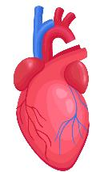


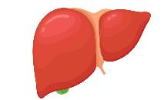

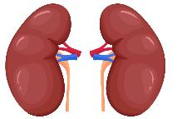
Nonalcoholic Fatty Liver Disease is Associated With Metabolic Dysregulation
Beta cell dysfunction
Insulin resistance
T2DM
Myocyte dysfunction
Heart failure with preserved ejection fraction
Metabolic stress
Metabolic dysfunction
NAFLD
Hepatic insulin resistance
Impaired fasting glucose
Hypertension
Peripheral vascular disease
Coronary artery disease
Dysregulated lipolysis
Inflammation
Chronic kidney disease
Vascular injury
NAFLD, nonalcoholic fatty liver disease; T2DM, type 2 diabetes mellitus.
Adapted from: Chakravarthy MV and Neuschwander-Tetri BA. Endocrinol Diabetes Metab. 2020;3(4):e00112.

Slide 23
Risk Factors and Conditions Associated With Nonalcoholic Fatty Liver Disease
Common conditions with established association with NAFLD | Other conditions associated with NAFLD
Obesity | Hypothyroidism
T2DM | Obstructive sleep apnea
Dyslipidemia | Hypopituitarism
Polycystic ovary syndrome | Hypogonadism
*Metabolic syndrome | Psoriasis
*Metabolic syndrome is defined by the presence of ≥3 of the following features or established conditions:
Obesity or waist circumference >102 cm in men or >88 cm in women
Triglyceride level ≥150 mg/dL or more
HDL cholesterol <40 mg/dL in men and <50 mg/dL in women
Systolic blood pressure ≥130 mmHg or diastolic blood pressure ≥85 mmHg or on treatment for hypertension
Fasting plasma glucose level 110 mg/dL or greater
HDL, high-density lipoprotein; NAFLD, nonalcoholic fatty liver disease; T2DM, type 2 diabetes mellitus.
Chalasani N, et al. Hepatology. 2018;67(1):328–357.

Slide 24


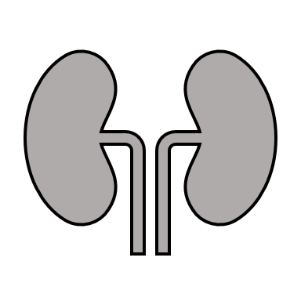
Relationships Between Nonalcoholic Fatty Liver Disease, Type 2 Diabetes and Metabolic Syndrome
There is an association between NAFLD/NASH and the risk of developing multiple extrahepatic complications
The magnitude of risk is linked to the severity of disease, particularly the stage of liver fibrosis
~0.5 to 2 times
increase in risk
~2 times
increase in risk
Cardiovascular
disease
~2.2 times increase in risk
Cardiovascular
disease
Type 2 Diabetes
Metabolic Syndrome
NAFLD
Steatosis
NASH
Liver fibrosis
Chronic
kidney disease
Chronic
kidney disease
~2.5 to 3.5 times
increase in risk
~2 to 6 times increase in risk (liver fibrosis)
~1.5 times
increase in risk
~10 to 100 times
increase in risk
Hepatocellular carcinoma
NAFLD, nonalcoholic fatty liver disease; NASH, nonalcoholic steatohepatitis.
Adapted from Targher G, et al. Lancet Gastroenterol Hepatol. 2021;6(7):578–588.

Slide 25
Patient Identification

Slide 26
Imaging and Biomarkers Modalities to Identify and Monitor Patients With Nonalcoholic Steatohepatitis Beyond the Biopsy
1. Evaluation scores
2. Imaging techniques beyond biopsy
3. Proprietary serum tests
Easily calculated with online calculators using information from standard liver tests and patient data¹
FIB-4 (and to a lesser degree NFS and APRI) are recognized in guidelines as clinically useful in identifying patients with a higher probability of F3/F4 fibrosis^{1,2,3}
Conventional ultrasound: historically used to identify steatosis despite known limitations¹
MRI/MRI-PDFF: accurate for detecting and quantifying steatosis but time consuming and limited by the high cost and expertise required (use generally restricted to clinical studies)¹
VCTE (FibroScan): can assess both steatosis (CAP) and fibrosis (LSM). Point-of-care, most widely used and validated technique¹
MRE: accurate for detecting and quantifying fibrosis but limited by availability and cost¹
Tests for biomarkers to determine the presence of advanced fibrosis (F3/F4) or active NASH^{1,4}
ELF: FDA recently granted marketing authorization for ELF as a prognostic tool for monitoring progression to cirrhosis and liver-related clinical events in advanced patients. ELF is also widely used outside the US to determine the presence of F3/F4⁵
Other investigational serum tests include: PRO-C3 or NIS-4^{4,5}
APRI, aspartate aminotransferase to platelet ratio index; CAP, controlled attenuation parameter; CK-18, cytokeratin 18; ELF, enhanced liver fibrosis; FDA, Food and Drug Administration; F, fibrosis stage; FIB-4, fibrosis-4 index for liver fibrosis; LSM, liver stiffness measurement; MRI, magnetic resonance imaging; MRI-PDFF, magnetic resonance imaging derived proton density fat fraction; MRE, magnetic resonance elastography; NAFLD, nonalcoholic fatty liver disease; NAS, NAFLD activity score; NFS, NAFLD fibrosis score; PRO-C3, N-terminal type 3 collagen propeptide; VCTE, vibration-controlled transient elastography.
1. EASL Clinical Practice Guideline Panel. J Hepatol. 2021;75(3):659–689; 2. Chalasani N, et al. Hepatology. 2018;67(1):328–357; 3. Kanwal F. et al. Gastroenterology. 2021;161(5):1657–1669; 4. Loomba R, Adams LA. Gut. 2020;69(7):1343–1352; 5. https://www.siemens-healthineers.com/en-us/laboratory-diagnostics/assays-by-diseases-conditions/liver-disease/elf-test (accessed January 2022); 6. https://nis4.com/ (accessed January 2022).

Slide 27

Practical Application of Noninvasive Assessments of Liver Fibrosis
Case study
57-year-old male with T2DM and hypertension
Denies smoking or alcohol/drug use
Negative for viral hepatitis
Current medications:
  Losartan 50 mg BID, hydrochlorothiazide 12.5 mg QID, glipizide 10 mg BID, metformin 1000 mg BID
BMI 35.6 kg/m²
Current blood parameters of significance:
  AST 51 IU/L, ALT 65 IU/L, GGT 83 IU/L, platelet count 155×10⁹/L, HgA1c 8.1%, albumin 3.5 g/dL
Age (years)
AST level (IU/L)
57
x
51
FIB-4
=
=
2.33
Platelet count (10⁹/L)
ALT level (IU/L)
x
$$√$$
155
65
Multiple FIB-4 calculators are available online. One such example:
https://www.mdcalc.com/fibrosis-4-fib-4-index-liverfibrosis
ALT, alanine aminotransferase; APRI, aspartate aminotransferase to platelet ratio index; AST, aspartate aminotransferase; BID, twice daily; BMI, body mass index; FIB-4, fibrosis-4 index for liver fibrosis; GGT, gamma-glutamyl transferase; HgA1c, glycated hemoglobin; IFG, impaired fasting glucose; NAFLD, nonalcoholic fatty liver disease; QID, four times daily; T2DM, type 2 diabetes mellitus.
Fictious case. This slide does not constitute medical advice.

Slide 28
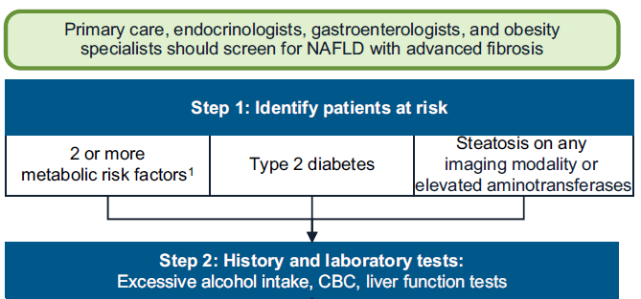
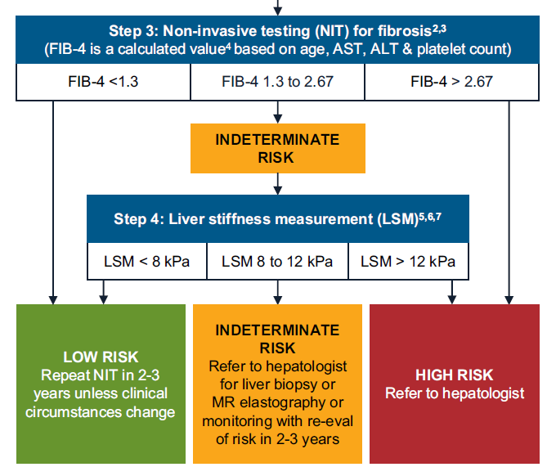
AGA Screening Algorithm for Advanced Fibrosis Related to Nonalcoholic Fatty Liver Disease*
Metabolic risk factors: central obesity, high triglycerides, low HDL cholesterol, hypertension, prediabetes, or insulin resistance.
For patients 65+, use FIB-4 < 2.0 as the lower cutoff. Higher cutoff does not change.
Other NITs derived from routine laboratories can be used instead of FIB-4.
Many online FIB-4 calculators are available such as https://www.mdcalc.com/fibrosis-4-fib-4-index-liverfibrosis
Ultrasound acceptable if vibration-controlled transient elastography (VCTE, FibroScanR) is unavailable. Consider referral to hepatologist for patients with hepatic steatosis on ultrasound who are indeterminate or high risk based on FIB-4
LSM values are for VCTE (FibroScanR). Other techniques such as bidimensional shear wave elastography or point shear wave elastography can also be used to measure LSM. Proprietary commercially available blood NITs may be considered for patients considered indeterminate or high risk based on FIB-4 or APRI, or where LSM unavailable.
Eddowes et al.† used 8.2 and 12.1 kPa as cutoffs for LSM using VCTE. Validation of simple (rounded) cutoffs reported by Papatheodoridi et al.‡
* Kanwal F. et al. Gastroenterology. 2021;161(5):1657–1669; † Eddowes PJ, et al. Gastroenterology. 2019;156(6):1717–1730; ‡ Papatheodoridi M, et al. J Hepatol. 2021;74(5):1109–1116.

Slide 29
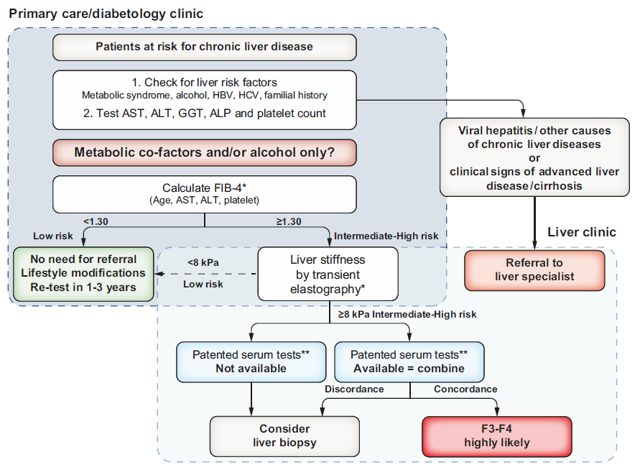
EASL Screening Algorithm for Advanced Fibrosis Related to Liver Diseases, including Nonalcoholic Fatty Liver Disease
Proposed use of screening algorithm in patients observed in primary care or outside the liver clinic
As shown, FIB-4 can be used in patients with metabolic co-factors to identify patients requiring referral to the specialist liver clinic.
*Transient elastography or FIB-4 may be performed before or after referral to liver specialist according to local availability and pathways. **Cut-offs to use: ELF 9.8 (NAFLD/ALD); FibroMeter 0.45 (NAFLD), Fibrotest 0.48 (NAFLD).
ALD, alcoholic liver disease; ALP, alkaline phosphatase; ALT, alanine aminotransferase; AST, aspartate aminotransferase; EASL, European Association for the Study of the Liver; ELF, enhanced liver fibrosis; F, fibrosis stage; FIB-4, fibrosis-4; GGT, gamma-glutamyl transferase; NAFLD, nonalcoholic fatty liver disease.
EASL Clinical Practice Guideline Panel. J Hepatol. 2021;75(3):659–689.

Slide 30
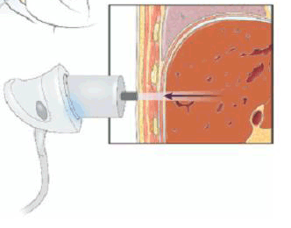
Imaging Techniques Can Assess Both Steatosis and Fibrosis
Ultrasound-based imaging (VCTE, FibroScan™) can assesses both steatosis and fibrosis¹⁻⁵
Designed to explore a 3 cm³ volume of liver tissue
50-Hz shear wave induced from tip of FibroScan probe
A
LSM vs fibrosis stage⁵
LSM (kPa)
  Fibrosis:
  Moves slowly in healthy liver, quickly in a cirrhotic liver.
  Liver stiffness can be used to infer presence of fibrosis, although specific cut offs are not able to discriminate between individual fibrosis stages⁴
B
CAP vs steatosis grade⁵
CAP (dB/m)
Steatosis:
Can simultaneously measures liver fat using CAP (expressed in db/m)
CAP, controlled attenuation parameter; VCTE, vibration-controlled transient elastography; TE, transient elastography.
1. Castera L, et al. J Hepatol. 2008;48(5):835–847; 2. Tapper EB and Lok AS. N Engl J Med. 2017;377(8):756–768; 3. Centex Studies. 2020. Available at: https://www.centexstudies.com/understanding-fibroscan-results 'accessed Sept 2021]; 4. Selvaraj EA, et al. J Hepatol. 2021;75(4):770–785; 5. Eddowes PJ, et al. Gastroenterology. 2019;156(6):1717–1730.

Slide 31

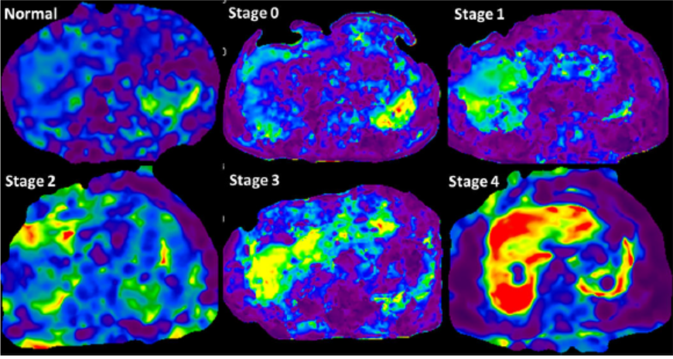
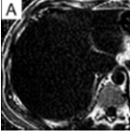
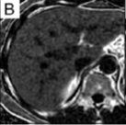
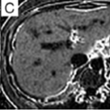
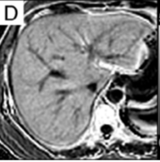
Imaging Techniques Can Assess Both Steatosis and Fibrosis
MR-based imaging can assesses both steatosis and fibrosis^{1–4}
MR Elastography (kPa)
Fibrosis:
Modified phase-contrast pulse sequence to visualize rapidly propagating mechanical shear waves (~60 Hz)¹
MRE Stiffness maps showing increasing liver stiffness with increasing stages of fibrosis¹
MRI-PDFF
(% fat fraction)
Steatosis:
Exploits the difference in resonance frequencies of protons in water and fat to provide estimates of tissue fat fraction^{2–4}
2.2 %
11.4%
20.1%
30.1%
MR, magnetic resonance; MRI-PDFF, magnetic resonance imaging proton density fat fraction
1. Hoodeshenas S, et al. Top Magn Reson Imaging. 2018;27(5):319–333. 2. Tang A, et al. Radiology. 2015;274(2):416–425; 3. Caussy C, et al. Hepatology. 2018;68(2):763–772; 4. Di Martino M, et al. World J Gastroenterol 2016;22:8812–8819.

Slide 32
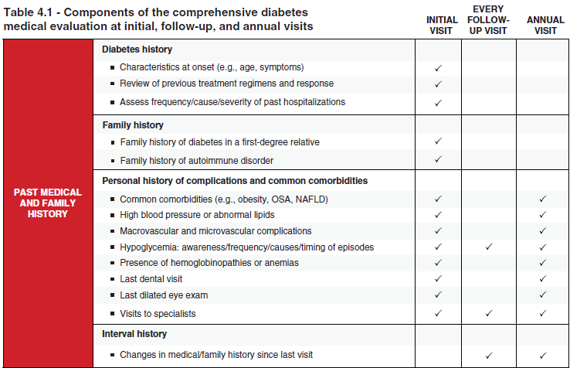
Recommendations From the American Diabetes Association
Patients with type 2 diabetes or prediabetes and elevated liver enzymes (ALT) or fatty liver on ultrasound should be evaluated for the presence of nonalcoholic steatohepatitis and liver fibrosis. Evidence level C
ALT, alanine aminotransferase; NAFLD, nonalcoholic fatty liver disease; OSA, obstructive sleep apnea.
American Diabetes Association Professional Practice Committee. Diabetes Care. 2022;45(Suppl. 1):S46–S59.

Slide 33
Patient Perspective

Slide 34
Survey of Overall Reported Symptoms of Patients With Nonalcoholic Steatohepatitis
There are often no specific symptoms associated with NASH, the most common are fatigue, overweight and abdominal pain
Total Surveyed
(n=166)
NASH, nonalcoholic steatohepatitis.
Adapted from Cook N, et al. Front Med 2019;6(61):1–14.

Slide 35
Components of Lifestyle Approach to Manage Nonalcoholic Fatty Liver Disease
Energy restriction
Calorie restriction (500−1,000/day)
7−10% weight loss target
Long-term maintenance approach
Reduce fructose intake
Avoid fructose-containing
food and drink
Comprehensive lifestyle approach
Control daily alcohol intake
Strictly below 30 g for men
and 20 g for women
Coffee consumption
No liver-related limitations
Increase physical activity
150−200 min/week moderate intensity in 3−5 sessions
Resistance training to promote
musculoskeletal fitness and improve metabolic factors
Macronutrient composition
Low-to-moderate fat intake
Low-carbohydrate ketogenic or high protein diets
Mediterranean diet rich in mono-unsaturated fatty acids, with high intakes of olive oil, nuts, vegetables, fruits, legumes, whole grains and fish
Adapted from EASL–EASD–EASO. J Hepatol. 2016;64:1388–1402; Hallsworth K and Adams LA. JHEP Reports. 2019;1(6):468–479.

Slide 36
Disease Summary
NAFLD encompasses the entire spectrum of fatty liver disease including NASH, the progressive form of the disease
Chronic and excessive steatosis induces lipotoxicity, inflammation and hepatocellular injury followed by fibrogenesis
NASH with fibrosis can progress to cirrhosis, risk factor for HCC development
Globally, 25% of adults are suspected of having NAFLD
  Consequently 5–6% of adults worldwide potentially have NASH
Overall mortality is increased in NAFLD, specifically cardiovascular diseases in the early stages and liver-related deaths at the more advanced fibrosis stages
NAFLD continues to be a chronic liver disease that is increasing in prevalence
From 2015 to 2030, the projected prevalence of NASH in the US is expected to rise by over 60%
NAFLD is associated with a variety of metabolic comorbidities, including obesity, type 2 diabetes, dyslipidemia and the metabolic syndrome
The current work-up for NAFLD involves scores based on blood parameters and imaging techniques
Patients have a role in their risk mitigation through lifestyle
HCC, hepatocellular carcinoma; NAFLD, nonalcoholic fatty liver disease; NASH, nonalcoholic steatohepatitis.

