Slide 1


Slide 2


Slide 3


Slide 4
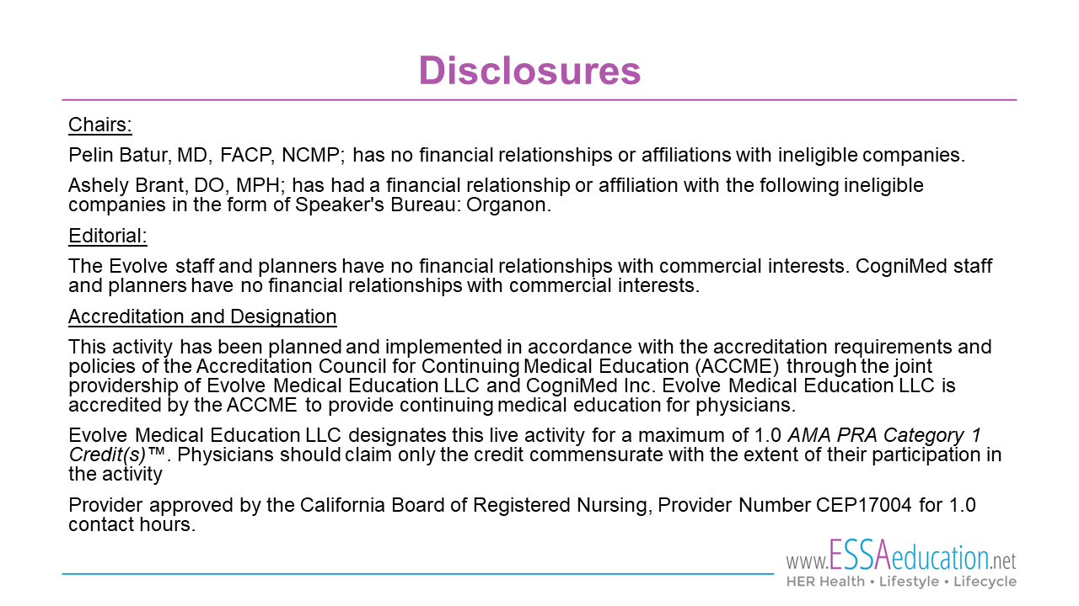

Slide 5

Missed opportunities:
Emergency Contraception
Pelin Batur MD, FACP, NCMP
Professor of Ob/Gyn & Reproductive Biology
Deputy Editor, CCJM
Ashley Brant, DO, MPH
Assistant Professor of Ob/Gyn & Reproductive Biology
Director of Complex Family Planning

Slide 6
Objectives
Improve knowledge regarding mechanism of action and efficacy of emergency contraception (EC)
Discuss barriers to EC use and explore strategies to overcome barriers
Increase the rate EC counseling and provision/prescription
Update on newer contraceptive methods

Slide 7
Disclosures
PB: None
AB: Nexplanon trainer, Bayer advisory panel on postpartum IUDs
Discussion of off-label use of IUDs
Educational grant from ESSAeducation.net
  to help make session available online without cost outside of Cleveland Clinic
  no impact on session content which was developed by the speakers

Slide 8
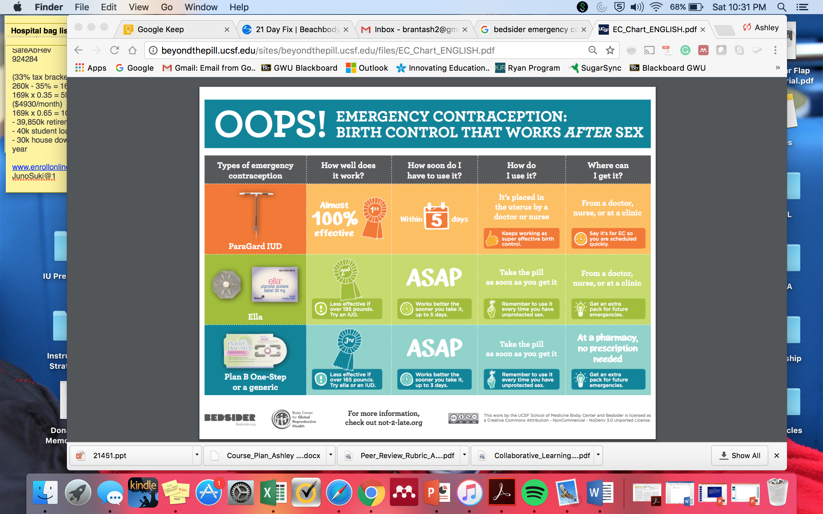
Not all EC is Plan B – important differences
Not medication abortion

Slide 9
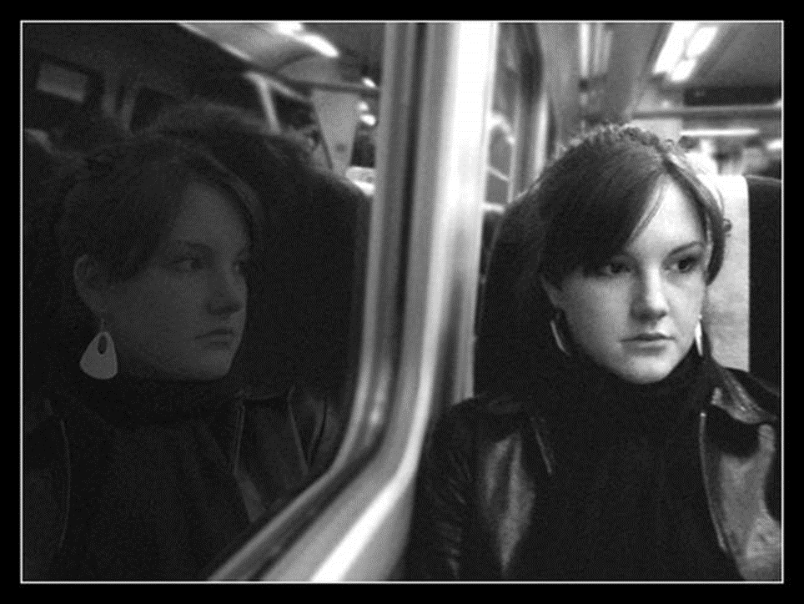
What if…?
…the condom broke
or slipped off...
…she forgot her regular
birth control...
…she was forced
to have sex...

Slide 10
Combined Pills (Yuzpe method)
Consider when LNG, UPA or IUD are not available
100 mcg EE q 12 hours x 2 doses
Name | 1st dose | 2nd dose (12 hours later) | Ethinyl Estradiol per dose (µg) | Levonorgestrel per dose (mg)
Aviane | 5 pills | 5 pills | 100 | 0.50
Lybrel | 6 pills | 6 pills | 120 | 0.54
Ogestrel | 2 pills | 2 pills | 100 | 0.50
Portia | 4 pills | 4 pills | 120 | 0.60
Sronyx | 5 pills | 5 pills | 100 | 0.50
Trivora | 4 pills | 4 pills | 120 | 0.50

Slide 11
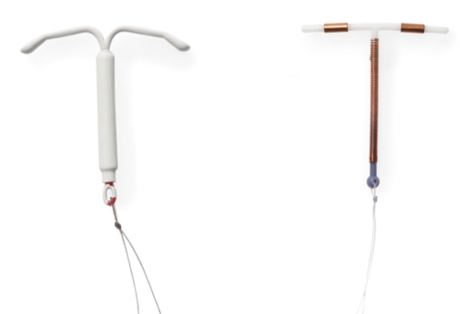
IUDs Oral EC
All can be used within 5 days of intercourse

Slide 12
The Methods
Notes:
anticipated pregnancy rate after randomly timed intercourse is ~6%.

Slide 13
Copper IUD (Cu IUD)
Primarily prevents fertilization
  Local foreign body reaction
  Impairs sperm viability and motility
May also impair ovum transport and embryo implantation
Ortiz 2007
Notes:
there was a study demonstrating that early embryo demise (prior to or immediately after implantation) was less common in Cu IUD users than in women not using any contraception at all.

Slide 14
Copper IUD (Cu IUD)
99.9% effective within 5 days
    Pregnancy rate of 0.4%
    Additional evidence for use up to 10 days
    SPR: within 5 days of sex or 5 days of ovulation
> 60% will continue to use it for LARC
    50% reduction in pregnancy rate
    at 12 months compared to oral EC
Cleland 2012, Sanders 2017, Shen 2019
CDC SPR 2016.
Turok 2013, Schwarz 2009, Wu BJOG 2010
Notes:
At least 3 studies have evaluated Cu IUD insertion up to 10 days after sex have demonstrated pregnancy rates of 0%, but the sample sizes are relatively small.
Turok -Cu IUDs inserted throughout the menstrual cycle =no pregnancies or serious adverse events.

Slide 15
Levonorgestrel IUD (LNG IUD)
Randomized, single blind, non-inferiority
52 mg LNG IUD (Liletta®) vs. Cu IUD (Paragard®)
N=638
Inclusion:
  Sex ≤ 5 days prior
  Negative pregnancy test
  Higher risk included
Primary Outcome:
  1 month pregnancy test
Notes:
Elevated BMI, additional acts of intercourse > 5 days prior to enrollment
When UPT data was not available they reviewed the EMR to see if they had subsequent healthcare encounters and whether there was documentation of pregnancy status in the EMR

Slide 16
52 mg LNG IUD
52 mg LNG IUD is non-inferior to Cu IUD IUD for EC
1 pregnancy in LNG IUD group (0.3%)
Notes:
Modified ITT: participants who received an IUD AND provided pregnancy data at 1 month
Per protocol: included only people who were still using their IUD at 1 month (excluded people who had their IUD removed or expulsed)
Sensitivity: excluded anyone without confirmed urine pregnancy test results

Slide 17
LNG IUD vs Cu IUD
No significant differences in:
  Expulsion rate
  Removal rate
  Satisfaction
  Adverse events resulting in medical care
Pain more common in Cu IUD group
More bleeding days in LNG IUD group
Turok D et al. N Engl J Med 2021; 384:335-344

Slide 18
52 mg LNG IUD
“These data can also support provision
of quick-start contraception with the levonorgestrel 52-mg IUD after recent unprotected sexual intercourse and a negative pregnancy test.”
Turok et al. NEJM 2021; 384(4):335

Slide 19
52 mg LNG IUD
LNG mechanism of action:
  Impairs sperm and ovum transport
  Impairs capacitation, the acrosome reaction, and ovum transport
Goksor 2010, Mahmood 1998, Nutu 2009, Tamburrino 2014
Notes:
MOA related to impaired ciliary function of the fallopian tube
also has a direct impact on the function of the sperm

Slide 20
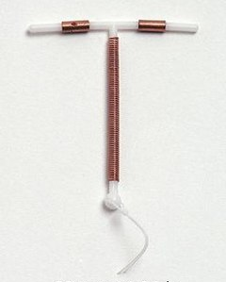
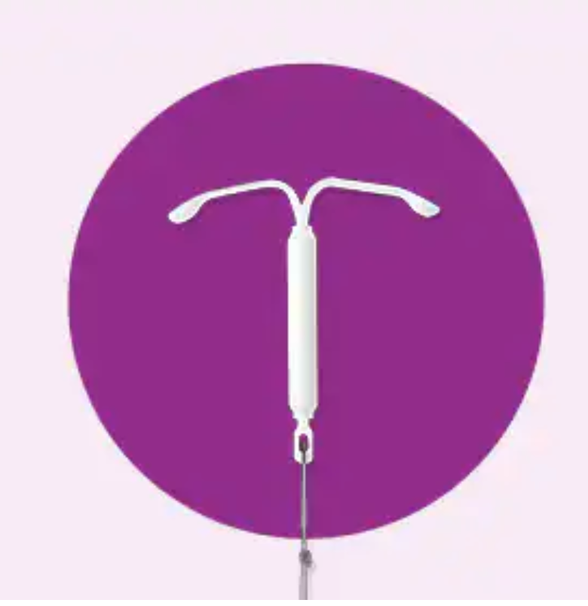
Bottom line
First line EC
=
IUDs
Notes:
efficacy and potential for long-acting contraception
Though logistic barriers exist

Slide 21
Oral EC

Slide 22
Ulipristal Acetate (UPA)
Single 30-mg dose
Selective progesterone receptor modulator (SPRM)
Delays follicular rupture¹
    100% effective in mid-follicular
    phase
    79% effective during LH surge
    prior to peak
    Doesn’t work after ovulation^{2.3}
1. Brache 2010 2. Noé. Contraception 2011;84:486-92. 3. Novikova. Contraception 2007;75:112-8.
Notes:
MOA is inhibition/delay of ovulation, and it remains effective until the peak of the LH surge. Ovulation is delayed by 5 days which coincides with the lifespan of spermatazoa in the female reproductive tract.

Slide 23
Ulipristal Acetate (UPA)
Possible effect on tubal ciliary function
  No increased risk of ectopic
Questionable impact on sperm
No effect on endometrium
    No impact on implantation,
    miscarriage, or teratogenicity
Levy 2014, Rosatto 2014, Gemzell-Daniellson 2014
Notes:
2nd MOA may include effects on tubal transport or deleterious effects on sperm, but these mechanisms have mostly been investigated in vitro.

Slide 24
Ulipristal Acetate (UPA)
Consistent efficacy through 120 hours
    1.3% pregnancy rate when used within 120 hours
    FDA-approved through 120 hours
    Double the effectiveness of OTC lng EC
Side effects:
    Headache, dysmenorrhea, nausea
    Delayed menses (2 days)
No contraindications
Glasier 2010
Notes:
Compared to expected pregnancy rate of 5-6% without contraception…

Slide 25
Levonorgestrel (LNG)
Single 1.5 mg dose or 2 x 0.75 mg doses
Delays or inhibits ovulation
    Disrupts ovulation 96% of the
    time in the early follicular phase
    Ineffective after LH surge onset
Gemzell-Daniellson 2014
Notes:
inhibition of the LH surge. It’s very effective when used prior the onset of the LH surge, when follicle size is 12-17 mm, but loses efficacy once LH surge has begun.

Slide 26
Systematic review of Oral Lng EC
1325 articles reviewed, 33 studies assessed impact on:
  ovulation, conception, implantation, ectopic pregnancy, pregnancy viability, and fertility in subsequent cycles
Levonorgestrel EC acts by postponing or inhibiting ovulation
  little to no post-ovulatory action.
  evidence shows no impact on fetal development, miscarriage, stillbirth, or menstruation in subsequent cycles.
Endler et al. Contraception 2022;109: 8–18

Slide 27
Systematic review of Oral Lng EC
“Overall, the evidence is overwhelmingly in support of a lack of postovulatory implantation effect…”
Endler et al. Contraception 2022;109: 8–18
Notes:
Although lng sometimes affects endometrial receptivity if taken before the LH surge, it has no effect on receptivity or blastocyst attachment after ovulation.
Only a few animal models have demonstrated impaired endometrial function when LNG was administered post-ovulation, but these studies use extremely high doses of LNG (40 mg/kg) so you can’t extrapolate to human use.

Slide 28
Levonorgestrel (LNG)
Efficacy
    2.2% pregnancy rate when used within 120 hours
    Waning efficacy with time, especially > 72 hrs
FDA-approved through 72 hours
Side effects:
    Nausea, abdominal pain, headache
    Early menses
No contraindications
OTC
Glasier 2010
Notes:
According to a meta-analysis…. twice the rate of pregnancy compared to UPA, but still well below the expected pregnancy rate in the absence of EC.
The only contraindication is known pregnancy, and that’s not because of risk its because of inefficacy
available OTC since 2013, without age or gender limitations

Slide 29
Copper IUD
Levonorgestrel IUD
UPA
LNG
Image from Bullock Obstet Gynecol Clin N Am 2015
Notes:
IUDs exert a MOA independent of the menstrual cycle, UPA is effective until the LH peak, and LNG is effective until LH begins to rise.

Slide 30
Key point break…
Cu IUDs are the most effective form of EC
Lng IUD is an emerging option
Ulipristal and Lng oral EC both work by delaying ovulation
UPA more effective than Lng oral EC

Slide 31
Are there patient or situation characteristics that affect EC efficacy?

Slide 32
Predictors of oral EC failure
BMI / weight
    25-29.9: 1.7%
    ≥30: 4.3%
Use during “fertile window”
    2.9%
Subsequent intercourse
    6.4%
Glasier 2011
Notes:
conducted a study to determine if we can predict for whom oral EC will fail. Three factors were found to correlate with increased pregnancy rates…conception probability (which is determined by the cycle-day)
Subsequent acts of intercourse completely negated the effect of EC.

Slide 33
BMI and Pregnancy Rate
BMI | UPA | LNG
 | % (95% CI)
<25 | 1.1 (0.6-1.9) | 1.3 (0.8-2.2)
25-29.9 | 1.1 (0.4-2.7) | 2.5 (1.3-4.6)
≥ 30 | 2.6 (1.2-5.6) | 5.8 (3.5-9.5)
Cu IUD > UPA > LNG
ESHRE 2015, Glasier 2011, Creinin 2006
Notes:
Lng may be totally ineffective at a BMI of 30 or higher, 1/3 of American women have a BMI of 30
WHO data from 16 countries including 6800 women does not show the same effect of obesity- some methodological flaws with the WHO data

Slide 34
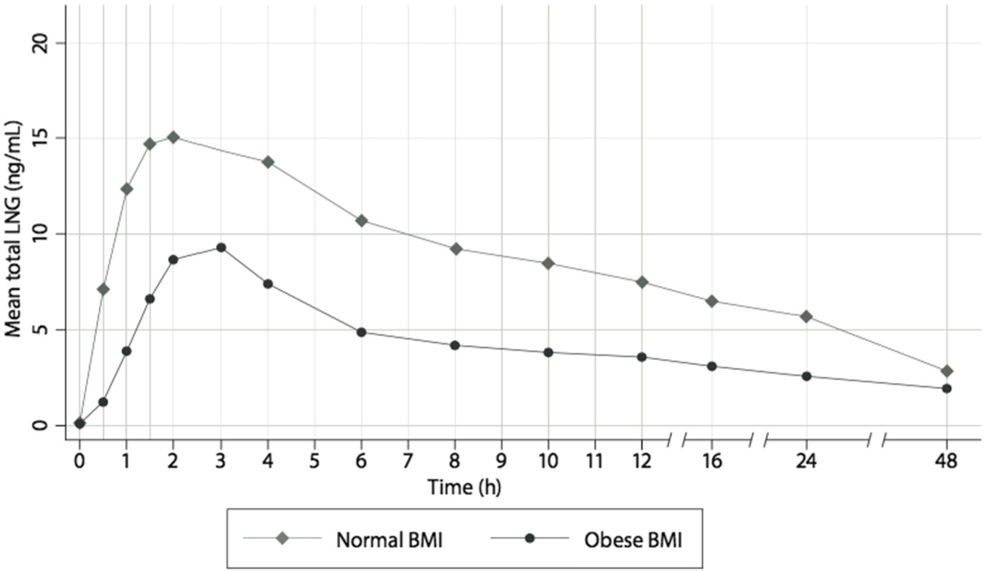
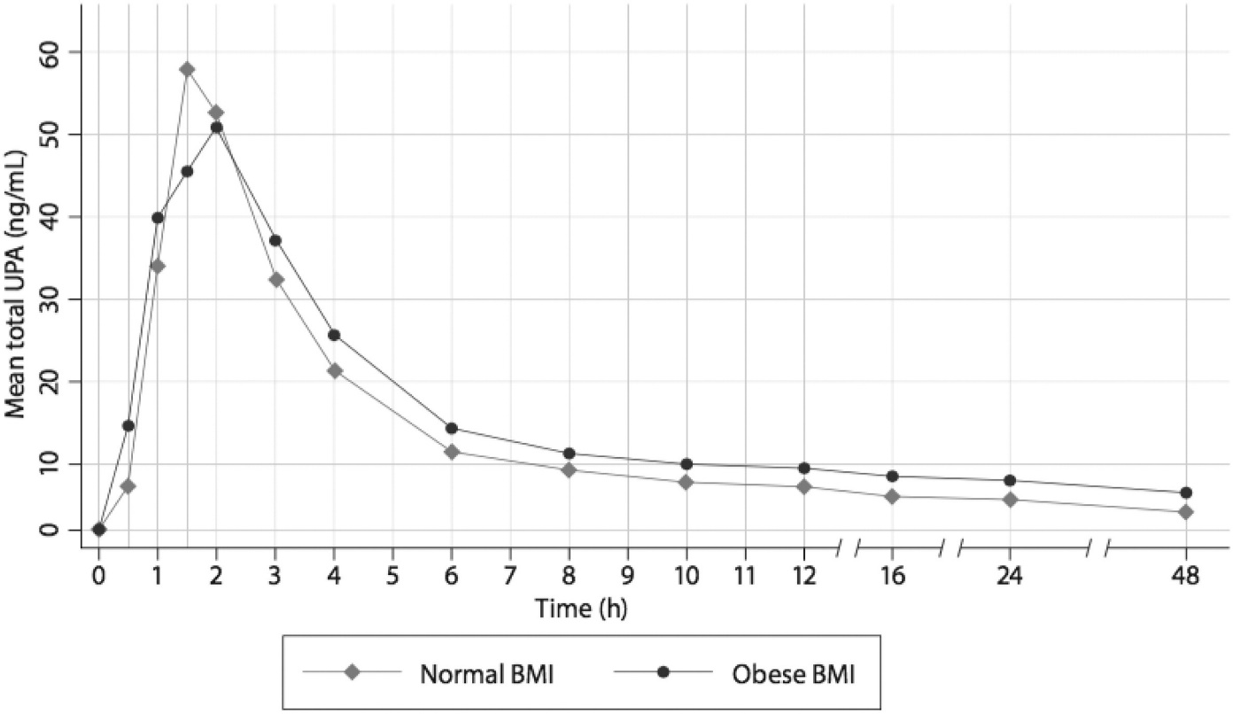
Pharmacokinetics
LNG
UPA
Praditpan 2017
Notes:
Obese women had ½ the serum concentration of LNG. This difference is not seen for UPA.

Slide 35
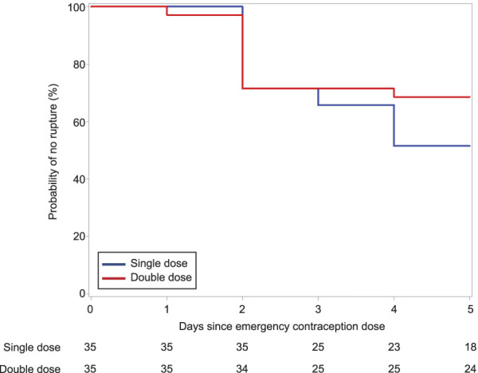
Double-Dose of LNG?
No difference in the rate of follicle rupture among women weighing >175 lbs
(p=0.2)
Edelman et al. Obstet Gynecol 2022;140(1):48-54.
Notes:
One study demonstrated that a double dose, or 3 mg dose of LNG, allowed women with obese BMI to achieve similar serum concentrations compared to normal BMI women using the typical dose. However, a new study pushed this year showed that there was no decrease in the rate of follicle rupture when the LNG dose was doubled in overweight women.

Slide 36
Efficacy vs. Time
Notes:
The next characteristic that affects EC efficacy is when in the cycle unprotected sex occurred and how quickly EC is taken.

Slide 37
Initiating EC
No need to rule out pregnancy prior to EC pill use
    Advance prescribing is safe, reduces barriers
Usual contraindications to IUDs
No contraindications to EC Pills

Slide 38
Counseling Patients
LNG: menses may occur earlier
UPA: menses may be delayed
  Pregnancy test if:
    Menses does not occur within 3 weeks
    Irregular bleeding
    Pelvic/abdominal pain
Glasier 2010
Notes:
next menses may be mistimed. LNG menses occurs 1-2 days early. After UPA menses occurs up to a week late.

Slide 39
Counseling Patients
Oral EC does NOT protect against subsequent sexual encounters
    Use barrier method until next menses
Oral EC side effects:
    1 in 5 headache
    1 in 10 dysmenorrhea, nausea
    1 in 20 fatigue, dizziness, abdominal pain
Notes:
Unless they get a Copper IUD, it does not protect against future sexual encounters.

Slide 40
EC and Breastfeeding
LNG EC
  No restrictions
  No need to “pump and dump”
UPA EC
  US label does not recommend, but research shows UPA is suitable for breastfeeding women
  Pump and discard milk for 24 hours* or one week**
Breastfeeding women may not need EC if:
  Exclusively breastfeeding and
  Baby is younger than 6 months and
  Period has not returned
*US Medical Eligibility Criteria for Contraceptive Use, 2017
**UK Faculty of Sexual and Reproductive Healthcare, 2017; European ellaOne label

Slide 41
EC and Drug Interactions
Hepatic enzyme inducers
  Could reduce effectiveness of UPA and LNG EC
  1st choice: Cu IUD (Lng not well studied)
  2nd choice: double dose (3.0mg) LNG (efficacy uncertain)
  UPA not recommended
Faculty of Sexual & Reproductive Healthcare. FRSH Guideline: Emergency contraception. May 2017.
Notes:
rifampicin, some anticonvulsants, griseofulvin

Slide 42
When should regular contraception be initiated after oral EC?

Slide 43
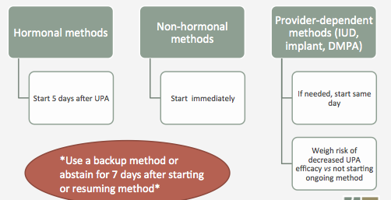
Initiating Contraception
30% of women report same-cycle sex after EC
Glasier 2015, Cheng 2015, Brache 2015, Curtis 2016, CDC SPR
Notes:
Subsequent sex in the same cycle essentially negates the benefit of oral EC and therefore it makes sense that we should encourage regular contraceptive use asap after EC. Historically, women were told to wait until their next cycle to start HC. That’s not necessary for women using oral LNG
concern that a woman may not be able to return to the office or clinic 5 days after taking UPA..The CDC guidelines state that

Slide 44
Key points break…
 | IUD | UPA (Ella) | LNG (Plan B)
Timing FDA-approved Evidence-based | 5+ days | 5 days 5 days | 3 days 5 days
Pregnancy rate (0-120 hr) | 0.1-0.3% | 1.3% | 2.2%
Side Effects | Pain, menstrual changes | Headache, dysmenorrhea, nausea | Headache, dysmenorrhea, nausea
Obesity | No effect | BMI ≥ 30 | BMI ≥ 25
Access | Clinician visit | Prescription | OTC
Initiating contraception | N/A | Delay 5 days | Quick start any method

Slide 45
Unfortunately…
The potential of EC has not been realized
  > 15 studies have evaluated the effect of EC on the unintended pregnancy rate
    Only 1 study showed an effect
Shaaban 2013
Notes:
population-based studies
Even with advanced provision, more than half of patients don’t use EC when indicated.

Slide 46
Why?
Individual factors
  Knowledge and attitudes
  Patients, physicians, pharmacists
System factors
  Cost, prescription, clinic visit
Time
  ASAP!

Slide 47
EC Access Barriers – UPA
Prescription-only
Awareness among providers very low¹
52% of RH providers, 20% of all providers had heard of it
14% of RH providers, 4% of all providers prescribe
Stocking in pharmacies is very low²
10% of pharmacies had UPA in stock
65% could order it, mean wait time of 24 hours
References: Batur 2015; Shigesato 2017
1. Batur et al. Contraception 2015
2. Shigesato et al. Contraception 2017

Slide 48
ACOG recommendations
Women should be educated about the availability of EC in advance of need
Write advance prescriptions for EC, particularly for females younger than 17 years, to increase awareness and reduce barriers to immediate access.
Integrate counseling about EC into all clinical visits of reproductive-aged women
ACOG PB 152 and CO 172
Notes:
The ACOG PB and COs on EC recommend that EC be discussed with all patients and that it’s totally appropriate to provide advanced prescriptions. This is especially important for young people who face unique barriers to access.

Slide 49
A new way to think about EC
Expands reproductive options
  Recognizes that methods can fail
  Recognizes that not all sex is wanted
  May be optimal BC for infrequent sex
Advance prescription = Birth control Band-Aid
Notes:
Historically, EC use has been framed as a response to a failure. We need to shift the way we think about it and consider it just another contraceptive option for women.
Having a prescription or actual pills for EC on hand in advance of needing it is really not that different from keeping band-aids in your house.

Slide 50
Patient Knowledge of EC
Most common source of knowledge is peers
Highly credible source →
increased intention to use EC
Garrett Wagner 2018
Notes:
Like other forms of contraception, young women report that they are most likely to hear about EC from their peers. However, women that reported learning about EC from a highly credible source, like a healthcare professional, they have more accurate knowledge and are 6x more likely to say they would use EC in the future if they needed it.

Slide 51
Room for Improvement
Counseling on EC is the strongest predictor of use
  Only 3% of women report being counseled about EC in the last year
From 2002-2016, ever-use increased from 4% to 28%
Mosher 2010, Daniels 2013, Heller 2019
Notes:
The silver lining is that there’s plenty of room for improvement in EC uptake. Prior counseling is the strongest predictor of EC use and it’s something that we’re all capable of. Women who had been counseled about EC were 8 times more likely to use EC. Knowing about EC and believing in its safety and efficacy are associated with EC use.

Slide 52
Common Misconception
EC access and use is associated with increased sexual risk-taking.
FALSE
Am J Public Health. 2009 Mar;99(3):441-2.
JAMA. 2005 Jan 5;293(1):54-62.
Notes:
There’s a common misconception that to promote EC is to promote risky sexual behaviors. Multiple studies have shown that improved access to EC is not associated with difference in rates of regular contraceptive use, STIs, unprotected intercourse, or condom use.
Am J Public Health. 2009 Mar;99(3):441-2. Study of French women accessing EC.
In 71% of the cases, no changes in contraceptive practices from the time of EC pill use to 6 months later: 41% of women continued use of highly effective methods and 30% continued less effective methods. 20% had switched to a more effective method while only 8.4% switched to less effective methods.
JAMA. 2005 Jan 5;293(1):54-62. Direct access to emergency contraception through pharmacies and effect on unintended pregnancy and STIs: a randomized controlled trial. Pharmacy access vs. advanced prescription vs control.

Slide 53
Systems Barriers

Slide 54
Pharmacy Availability
Pharmacy availability remains a barrier
  UPA available in ~10% of pharmacies
  LNG available in 80-90% of pharmacies
Know what your pharmacy stocks
Request pharmacy next-day delivery
Online birth control services
Shigesto 2017. Brant 2014.
Notes:
It may be necessary to counsel patients on which pharmacy to use because access to UPA remains a barrier. UPA is available in only 10% of pharmacies in both rural and urban areas. In one study, 65% of pharmacies provided incorrect information about EC over the phone. Pharmacy staff counseling is often poor quality. Factors associated with difficult accessing EC include being a teenager and being in the south.

Slide 55
Access to IUDs
Health system barriers
  Phone triage
  Nursing
  Schedulers
  Billing
Notes:
There are multiple points of stress within the healthcare system with regard to offering IUDs as EC

Slide 56
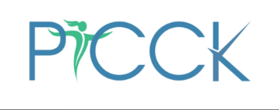
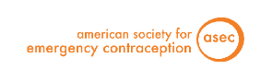
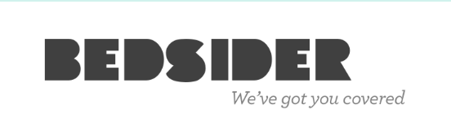
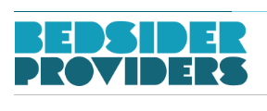
Other resources
Partners in Contraceptive Choice and Knowledge
  www.picck.org
American Society of Emergency Contraception
  www.americansocietyforec.org
www.bedsider.org and www.providers.bedside.org
Notes:
Resources include fact sheets, algorithms for phone triage for EC requests

Slide 57
Future Areas of Research
Reducing health system barriers to same day IUD
Nexplanon for EC
  Same-day oral EC + Nexplanon insertion

Slide 58
EC Take Home Points
Efficacy: IUD > UPA > LNG
EC is safe, effective, and well tolerated
Few contraindications
Advance counseling and prescribing is appropriate for almost everyone
Counseling and prescribing is not difficult
Tools for addressing systemic change are available

Slide 59
Contraceptive Update

Slide 60
Mirena IUD FDA-approved for contraception for 8 years!

Slide 61
Slynd® (Drospirenone 4 mg)
24/4 regimen
Analogue of spironolactone
DRSP antagonizes estrogen and blocks the renin-angiotensin-aldosterone system
Anti-mineralocorticoid | Anti-androgenic | Progestogenic
↑ sodium and water excretion by blocking aldosterone receptors | Blocks AR in skin Production of ovarian androgens ↓ | Inhibits ovulation by blocking LH surge
Krattenmacher R. Contraception 2000;62:29-38.
Notes:
An alternative for pts with estrogen contraindications that have tried and failed norethindrone of other POCs.
MoA: inhibition of ovulation and thickening of cervical mucus, Half life > 30 hours
Contrast this to norethindrone which does not reliable prevent ovulation, it works by thickening the cervical mucus, must be taken at the same time every day, and doesn’t have a pill-free interval.
Renal impairment and adrenal insufficiency are contraindications to using Slynd

Slide 62
Contraceptive effect of late pills
Intentional 24-hr delay in administration of pills on days 3, 6, 11, and 22
Participant took 2 pills on days 4, 7, 12, and 23
Efficacy likely high despite late pills
0.8%
Ovulation rate after 4
24-hr delays
Duijkers I, et al. Contraception. Apr 2016
Notes:
This data suggests that the guidance to women regarding a missed dose of Drospirenone-only can be the same as for newest COCs

Slide 63
Efficacy of DRSP-only POP by BMI
 | BMI <30 kg/m² N=590 | BMI ≥30 kg/m² N=325
Confirmed Pregnancy, n (%) | 8 (1.4) | 4 (1.2)
Pearl Index for evaluable cycles (95% CI) | 3.0 (1.3–5.8) | 2.9 (0.8–7.3)
Evaluable cycles | 3520 | 1817
Kimble T, et al. Contracept X. 2020 Jan 30
Notes:
1/3 had BMI > 30 and almost 1.5 had BMI > 35. The Pearl index which is a measure of contraceptive effectiveness was very similar between groups

Slide 64
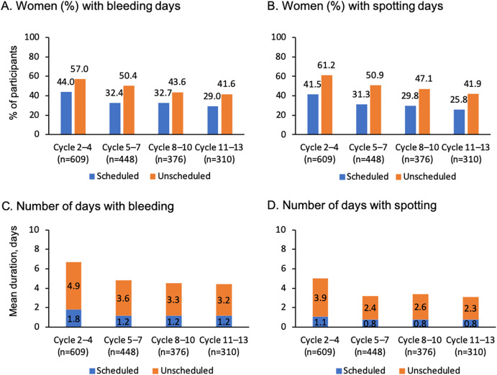
Discontinuation of drospirenone due to bleeding pattern during all clinical studies was minimal
Scheduled and unscheduled bleeding days declined over time
Percentage of women with unscheduled bleedings decreased from 71.4% in cycle 2 to 47.1% in cycle 13
3.5% of participants discontinuedDRSP during all of the clinical trials due to unacceptable bleeding patterns
96.5% acceptability of bleeding pattern
Palacios 2020. Kimble 2020.
Notes:
Percent of subjects with unscheduled bleedings decreased from 71.4% in cycle 2 to 47.1% in cycle 13
mean duration of unscheduled bleeding/spotting decreased from 4.1 days during the second cycle to 2.0 days in cycle 13
Image is from phase 3 trial paper.
Palacios S, et al. Oestrogen-free oral contraception with a 4 mg drospirenone-only pill: new data and a review of the literature. Eur J Contracept Reprod Health Care. 2020;:1-7
Menstrual bleeding disorders included metrorrhagia, irregular menstrual hemorrhage, vaginal hemorrhage, menorrhagia, uterine hemorrhage, and amenorrhea.

Slide 65






DRSP POP safety and side effects
No thromboembolic events were reported in the entire clinical program
No serious adverse events occurred during the Phase III studies
Only 2 cases (0.2%) of hyperkalaemia reported during long-term studies
No changes in haemostatic parameters
Safe for lactating women
Decreased BP in women with
borderline hypertension
Kimble T, et al. Contracept X. 2020
Notes:
No thromboembolic events in the more than 20,000 cycles
Additionally no weight gain and no impact on lipid parameters.
Excluded women with hx of VTE or increased risk for CV events

Slide 66
Is insurance coverage a barrier?
Pelin Batur’s smartphrase file for other pharmacy names:
  “.pharmacyme”
Cleveland Clinic Home Delivery
Will mail only to:
  Ohio / Florida / Nevada / Michigan / Virginia / West Virginia / Pennsylvania / Indiana

Slide 67
Nextstellis®
Daily combined oral contraceptive pill (24/4)
Drospirenone 4 mg + Estetrol 14.2 mcg
Smaller changes in hemostatic parameters compared to EE-LNG or EE-DRSP
  Lower risk for VTE?
Lesser impact on metabolic parameters
Douxfils et al. Contraception. 2020;102(6):396-402.
Creinin et al. Contraception. 2021;104(3):222-228.
Gemzell-Danielsson et al. BJOG 2022;129 (1): 63-71
Notes:
Phase 3 clinical trial limited to BMI <=35
Douxfils J, Klipping C, Duijkers I, Kinet V, Mawet M, Maillard C, Jost M, Rosing J, Foidart JM. Evaluation of the effect of a new oral contraceptive containing estetrol and drospirenone on hemostasis parameters. Contraception. 2020 Dec;102(6):396-402. doi: 10.1016/j.contraception.2020.08.015. Epub 2020 Sep 19. PMID: 32956694.
Creinin MD, Westhoff CL, Bouchard C, Chen MJ, Jensen JT, Kaunitz AM, Achilles SL, Foidart JM, Archer DF. Estetrol-drospirenone combination oral contraceptive: North American phase 3 efficacy and safety results. Contraception. 2021 Sep;104(3):222-228. doi: 10.1016/j.contraception.2021.05.002. Epub 2021 May 15. PMID: 34000251.

Slide 68
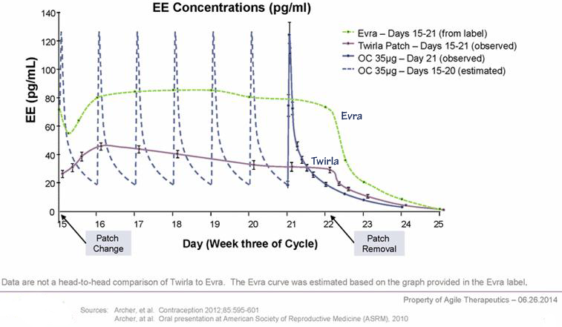
Twirla® vs Xulane® Transdermal
 | Twirla® | Xulane ®
Formulation | 30 mcg EE + Levonorgestrel | 35 mcg EE + Norelgestromen
Regimen | 21/7 | 21/7
Pearl Index | 5.83 | 1.07
Size | 28 cm² | 14 cm²
BMI | Not well studied in women with BMI > 30
Notes:
Pearl index: lower is better. Pregnancy rate per 100 woman-years
Twirla showed decreased efficacy in higher BMI group

Slide 69
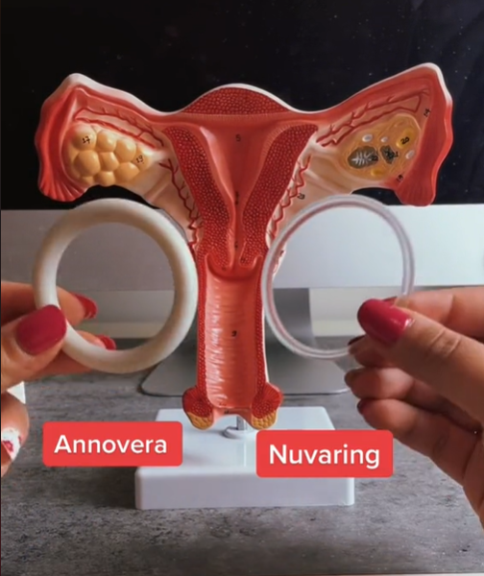
Annovera® vs NuvaRing®
 | Annovera® | Nuvaring®
Formulation | 13 mcg EE + Segesterone Acetate | 15 mcg EE + Etonorgestrel
Lifepsan | 13 cycles | 1 cycle
Pearl Index | 2.98 | 2.02
Size | 56 x 8.4 mm | 54 x 4 mm
Storage | Wash with soap and water, room temp | Refrigerate prior to use
Screenshot from TikTok
Notes:
Clinical trials on continuous use of annovera not published yet, but

Slide 70
We are here to help!
Consult complex contraception
E-consult women’s health

Slide 71
References
Bayer LL, Hillard PJA. Use of levonorgestrel intrauterine system for medical indications in adolescents. J Adolesc Heal. 2013;52(4 SUPPL.):S54–8.
Brache V, Cochon L, Jesam C, Maldonado R, Salvatierra AM, Levy DP, Gainer E, Croxatto HB. Immediate pre-ovulatory administration of 30 mg ulipristal acetate significantly delays follicular rupture. Hum Reprod. 2010 Sep 1;25(9):2256–63.
Cleland K, Zhu H, Goldstuck N, Cheng L, Trussell J. The efficacy of intrauterine devices for emergency contraception: a systematic review of 35 years of experience. Hum Reprod 2012;27:1994–2000.
Curtis KM, Jatlaoui TC, Tepper NK, Zapata LB, Horton LG, Jamieson DJ, Whiteman MK. U.S. Selected Practice Recommendations for Contraceptive Use, 2016. MMWR Recomm Reports. 2016 Jul 29;65(4):1–66.
Daniels K, Jones J, Abma J. Use of emergency contraception among women aged 15–44: United States, 2006–2010. NCHS Data Brief No. 112, February 2013.
ESHRE Capri Workshop Group. Emergency contraception.Widely available and effective but disappointing as a public health intervention: a review. Human Reproduction, Vol.30, No.4 pp. 751–760, 2015
Finer LB, Zolna MR. Declines in Unintended Pregnancy in the United States, 2008–2011. N Engl J Med. 2016 Mar 3;374(9):843–52.
Garrett Wagner KP, Widman L, Nesi J, Noar SM. Intentions to use emergency contraception: The role of accurate knowledge and information source credibility. Am J Health Educ. 2018;49(4):264-270. doi: 10.1080/19325037.2018.1473179. Epub 2018 Jun 7. PMID: 30397420; PMCID: PMC6214197.
Hernández-Silva G, Durand M, Larrea F, Chirinos M. Proteomic changes in uterine flushings after levonorgestrel treatment and effects on sperm function. Reproduction. 2018 Sep 12.

Slide 72
References
Glasier A, Cameron ST, Fine PM, Logan SJS, CasaleW, Van Horn J, Sogor L, Blithe DL, Scherrer B, Mathe H et al. Ulipristal acetate versus levonorgestrel for emergency contraception: a randomized non-inferiority trial and meta-analysis. Lancet 2010;375:555–562.
Glasier A, Cameron ST, Blithe D, Scherrer B, Mathe H, Levy D, Gainer E, Ulmann A. Can we identify women at risk of pregnancy despite using emergency contraception? Data from randomized trials of ulipristal acetate and levonorgestrel. Contraception. 2011;84(4):363–7.
Mosher WD, Jones J. Use of contraception in the United States: 1982-2008. Vital Health Stat 23. 2010 Aug;(29):1–44.
Ortiz ME, Croxatto HB. Copper-T intrauterine device and levonorgestrel intrauterine system: biological bases of their mechanism of action. Contraception 2007;75:S16–30.
Sable MR, Schwartz LR, Eleanor PJ, Lisbon MA. Using the Theory of Reasoned Action to Explain Physician Intention to Prescribe Emergency Contraception. Perspect Sex Reprod Health. 2006 Mar;38(1):20–7.
Sanders JN, Turok DK, Royer PA, Thompson IS, Gawron LM, Storck KE. One-year continuation of copper or levonorgestrel intrauterine devices initiated at the time of emergency contraception. Contraception. 2017 Aug;96(2):99–105.
Garrett Wagner, KP. Widman, L. Nesi, J. Noar, SM. Intentions to Use Emergency Contraception: The Role of Accurate Knowledge and Information Source Credibility, American Journal of Health Education. 2018; 49:4, 264-270

Slide 73
References
Shigesato M, Elia J, Tschann M, Bullock H, Hurwitz E, Wu YY, Salcedo J. Pharmacy access to Ulipristal acetate in major cities throughout the United States. Contraception. 2017 Oct 31;0(0).
Shaaban OM, Hassen SG, Nour SA, Kames MA, Yones EM. Emergency contraceptive pills as a backup for lactational amenorrhea method (LAM) of contraception: a randomized controlled trial. Contraception 2013;87:363–369.
Shaaban OM, Ali MK, Sabra AM, Abd El Aal DE. Levonorgestrel-releasing intrauterine system versus a low-dose combined oral contraceptive for treatment of adenomyotic uteri: a randomized clinical trial. Contraception. 2015;92(4):301–7.
Shen J, Che Y, Showell E, Chen K, Cheng L. Interventions for emergency contraception. Cochrane Database of Systematic Reviews 2019, Issue 1.
Wu S, Godfrey E, Wojdyla D, Dong J, Cong J, Wang C, von Hertzen H. Copper T380A intrauterine device for emergency contraception: a prospective, multicentre, cohort clinical trial. BJOG An Int J Obstet Gynaecol. 2010 Sep;117(10):1205–10.
North American Forum on Family Planning. Brant A, White K, St. Marie P. Using the Theory of Planned Behavior to influence resident physician emergency contraception prescribing patterns. Chicago, IL. 10/2015. Electronic Poster.
North American Forum on Family Planning. Brant A, White K, St. Marie P. Pharmacy availability of ulipristal acetate: an audit study. Miami, FL. 10/2014. Poster.

Slide 74
References
Praditpan, Piyapa et al. Pharmacokinetics of levonorgestrel and ulipristal acetate emergency contraception in women with normal and obese body mass index. Contraception. 2017. 95 (5): 464-469.
Heller C, Perreira KM, Shartzer A, Johnston EM, Courtot B. Emergency Contraception Use: The Influence of Awareness, Attitudes, and Beliefs Among Non-Hispanic White, Non-Hispanic Black, and Hispanic Women in the United States. Women's Health Issues 29-2 (2019) 161–169.
Goksör M, Billig H, Larsson DG. Rapid effects of progesterone on ciliary beat frequency in the mouse fallopian tube. Re-prod Biol Endocrinol 2010; 8: 48.
Mahmood T, Saridogan E, Smutna S, Habib AM, Djahanbakhch O. The effect of ovarian steroids on epithelial ciliary beat frequency in the human Fallopian tube. Hum Reprod 1998; 13: 2991-4.
Nutu M, Weijdegård B, Thomas P, Thurin-Kjellberg A, Billig H, Larsson DG. Distribution and hormonal regulation of membrane progesterone receptors beta and gamma in ciliated epithelial cells of mouse and human fallopian tubes. Re-prod Biol Endocrinol 2009; 7: 89.
Tamburrino L, Marchiani S, Minetti F, Forti G, Muratori M, Baldi E. The CatSper calcium channel in human sperm: relation with motility and involvement in progesterone-induced acrosome reaction. Hum Reprod 2014; 29: 418-28.

